Slide 1
Why Axis? Models the Boston Marathon
DATS 6101:Final Presentation
December 3, 2019

Slide 2
Boston Marathon Data
Our group chose to analyze data from the Boston Marathon in 2015-2017. Most of our work focuses on 2017, but we conducted analysis across all three years of data. The total size of the dataset is about 26,000 rows with 25 fields for each year. Fields include demographic information (age, gender, hometown and/or country) for each runner, the finishing time for each runner, and periodic times runners reached certain milestones along the course.
Boston Marathon Quick Facts
Oldest continually-run marathon in the world.
Attracts elite runners.
Must qualify with a previous Marathon, with qualifying times in the top 3-5% of all marathon times.
About 20% of participants are “charity” runners.
Geoffrey Kirui, of Kenya, beat American Galen Rupp by 21 seconds to win the Boston Marathon.

Slide 3
Boston Marathon Models
Our group was interested in answering several different questions through modeling:
How do the distribution of bib numbers correlate to finishing time? Can we find the groups to which different runners are assigned?
Based on all of our work with hometowns from EDA, can we model how far a runner travels to determine finishing time?
Can we model finishing time from just looking at how a runner does on the fourth quarter of the rank?
Are there ways to overcome the problems of collinearity for some of our data through PCA and PCR?
What model preforms best when using a runner’s pace to predict his finishing time?

Slide 4
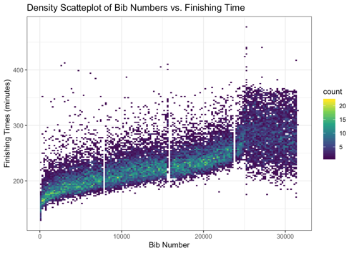
Modeling Clusters of Bib Numbers
Bibs are given out in a specific order, with four “waves” in 2019.
Faster runners were in earlier waves.
Red bibs (numbers 101 to 7,700) are assigned to Wave 1 (starting at 10:00 a.m.).
White bibs (numbers 8,000 to 15,600) are assigned to Wave 2 (starting at 10:25 a.m.).
Blue bibs (numbers 16,000 to 23,600) are assigned to Wave 3 (starting at 10:50 a.m.)
Yellow bibs (numbers 24,000 to 32,500) are assigned to Wave 4 (starting at 11:15 a.m.).

Slide 5
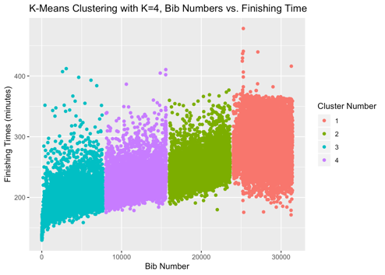
Modeling Clusters of Bib Numbers: K-Means
“Top-Down” Approach
Since there are four known clusters, we will provide ‘4’ as a parameter for the K-means algorithm.
Should run K-means multiple times since it starts with random seed.
Accurately identified clusters

Slide 6
Modeling Clusters of Bib Numbers: Hierarchical
“Bottom-Up” Approach
Three different methods. “Complete” worked best for this data.
After tree is built, user can set the “cut” line.
Hierarchical not as accurate as K-means.

Slide 7
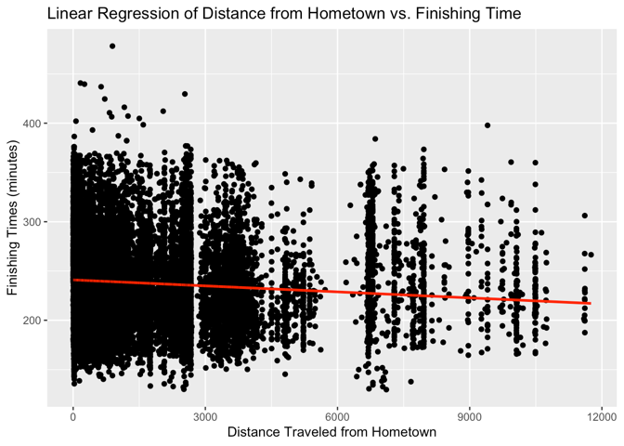
Modeling Distance Traveled From Hometown
Take each hometown provided by runners, pass it to Google Maps’ API, get the latitude/longitude, calculate distance traveled to start line, and join the distances with original data.
Model outputs are:
The R-squared value is 0.00713.
The p-value is ~0.
The coefficient for the distance variable is -0.00203.
The VIF is 1.
These outputs confirm what we see in the plot. For every mile further away a runner’s hometown is, a runner will run ~0.002 minutes faster.
However, we can see that this model is a very poor fit for the data with very high error residuals.
When building new features, even a lot of “really cool” analysis may lead to a terrible model. Try new things, but be suspicious!

Slide 8
Linear Regression: 4th quarter rank
Our previous analysis showed that:
Men are faster,
Younger runners are faster
Last quarter performance (rank) has the greatest impact on the overall (final) rank.
4th Quarter Rank~ bib number + age + gender
Variable | Coefficient | P-Value | VIF
(Intercept) | 1.66e+03 | <2e-16
Bib number | 5.57e-01 | <2e-16 | 1.30
Gender (male) | 1.42e+03 | <2e-16 | 1.30
Age | 4.56e+01 | <2e-16 | 1.17

Slide 9
Linear Regression: Official Time
Official Time ~ rank in each quarter + age+ gender
Variable | Coefficient | P-Value | VIF
(Intercept) | 1.671e+02 | <2e-16
1st quarter rank | 1.168e-03 | <2e-16 | 10.5641
2nd quarter rank | 1.118e-03 | <2e-16 | 23.9258
3rd quarter rank | 1.256e-03 | <2e-16 | 17.9686
4th quarter rank | 2.217e-03 | <2e-16 | 5.5925
gender | 3.369e+00 | <2e-16 | 1.3939
age | -1.568e-01 | <2e-16 | 1.2257
R^2: 0.434
Official Time ~ rank at 4th quarter + age+ gender
Variable | Coefficient | P-Value | VIF
(Intercept) | 1.727e+02 | <2e-16
4th quarter rank | 4.833e-03 | <2e-16 | 1.1009
gender | -1.070e+01 | <2e-16 | 1.0901
age | 1.792e-01 | <2e-16 | 1.1272

Slide 10
Linear Regression: Overall Rank
Overall Rank ~ rank in each quarter + age + gender
Variable | Estimate | P-Value | VIF
(Intercept) | -6.086e+02 | <2e-16
1st quarter rank | 1.859e-01 | <2e-16 | 10.5641
2nd quarter rank | 1.745e-01 | <2e-16 | 23.9258
3rd quarter rank | 2.902e-01 | <2e-16 | 17.9686
4th quarter rank | 4.014e-01 | <2e-16 | 5.5925
age | -3.653e+01 | 0.544320 | 1.2257
gender | -2.702e-01 | 0.000808 | 1.3939
R^2: 0.832
Overall Rank ~ rank at 4th quarter + age + gender
Variable | Coefficient | P-Value | VIF
(Intercept) | 3.733e+02 | 2.27e-10
4th quarter rank | 8.916e-01 | <2e-16 | 1.1009
age | -2.521e+03 | <2e-16 | 1.1272
gender | 5.824e+01 | <2e-16 | 1.0901

Slide 11
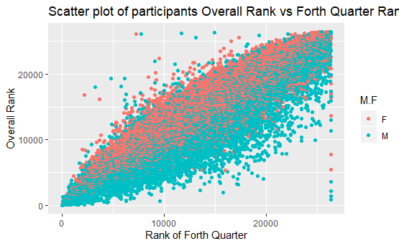
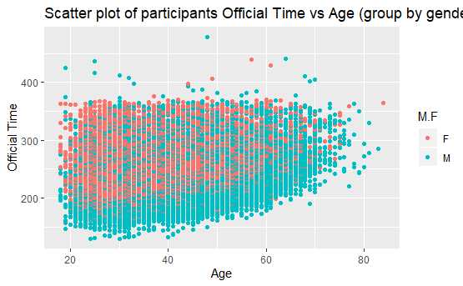
Official Time Distribution among Different Group

Slide 12
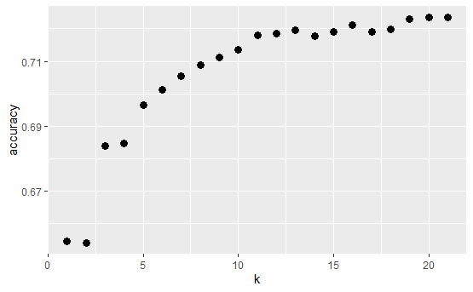
Official Time Prediction in KNN
Dependent variable(Categorical): Official Time
First quarter
Second quarter
Third quarter
Forth quarter
k=12, accuracy=72.5%
Cross Table | 1 | 2 | 3 | 4
1 | 1791 | 413 | 32 | 3
2 | 268 | 1316 | 549 | 40
3 | 3 | 431 | 1354 | 392
4 | 0 | 15 | 333 | 1795

Slide 13
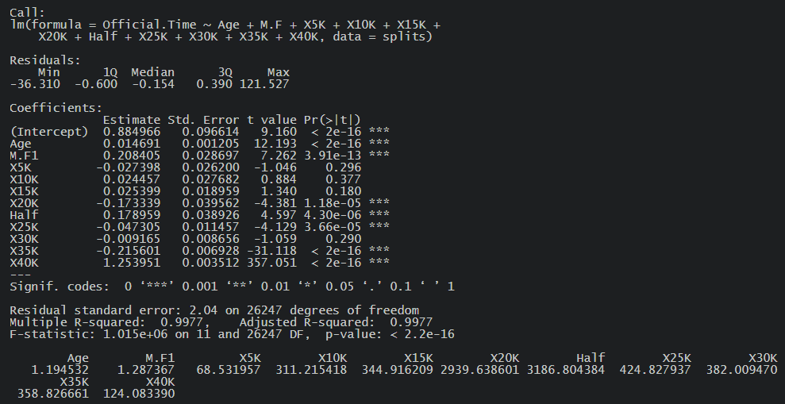
Linear Regression
Official.Time ~ Age + Gender + Each split time
Coefficients not significant.
R-squared value 0.9977
High VIF values suggesting multicollinearity in the data

Slide 14
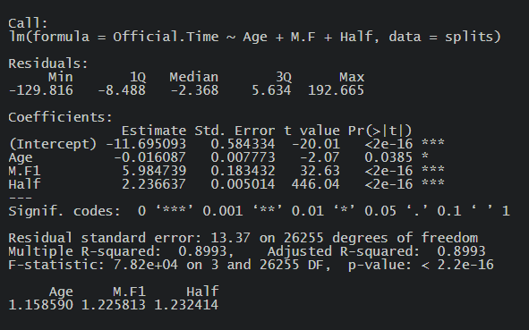
Linear Regression
Official.Time ~ Age + Gender + Half time
Coefficients significant.
p-value is ~0
R-squared value 0.8993

Slide 15
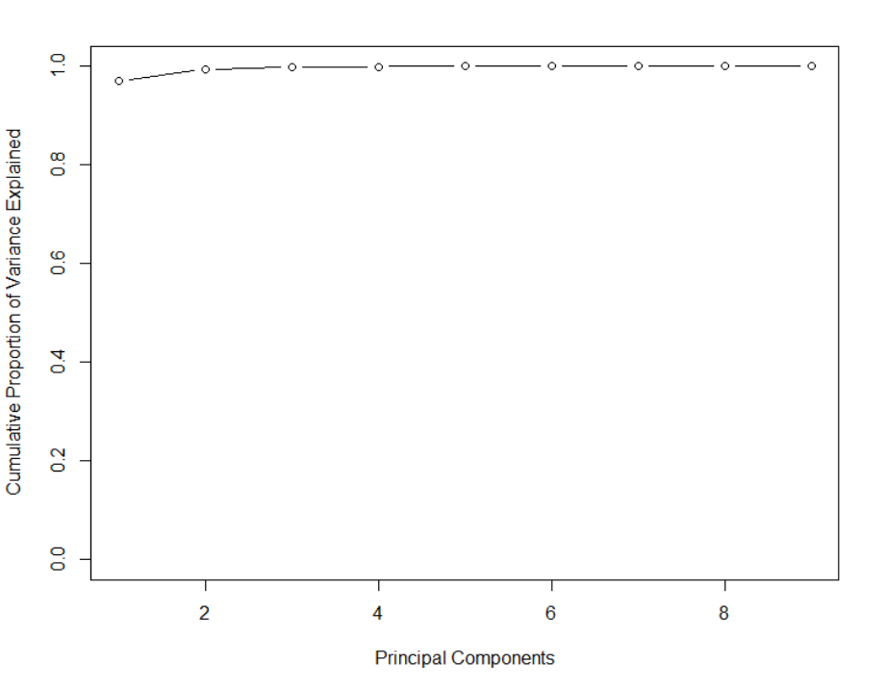
Principal Component Analysis
PC1 ~ 97% of the variance
PC1 + PC2 ~ 99% of the variance

Slide 16
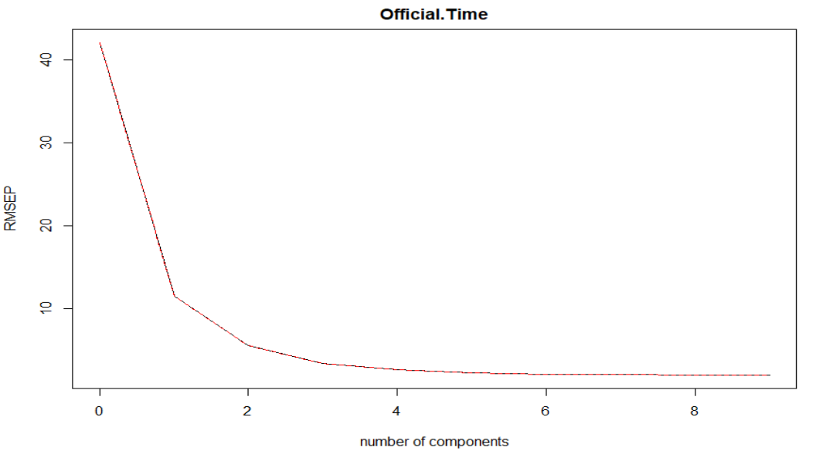
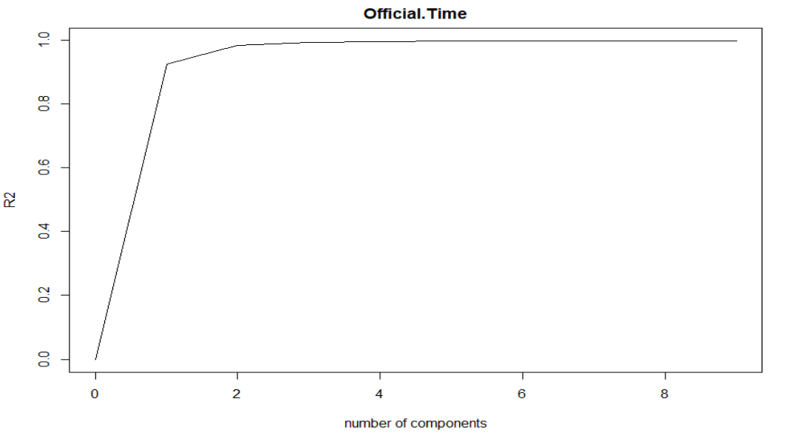
Principal Component Regression

Slide 17
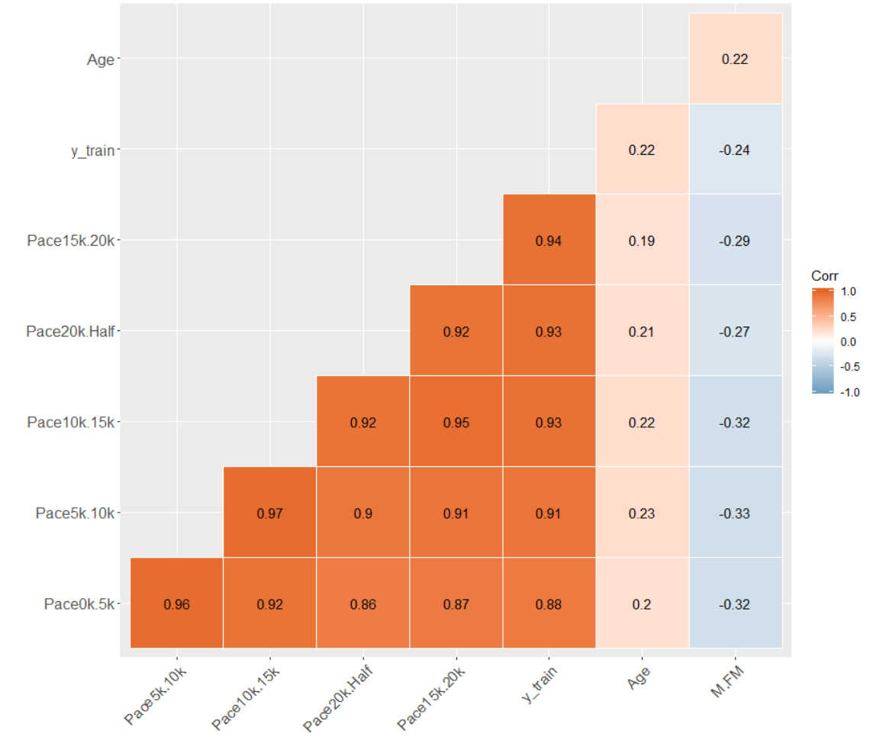
Correlation Matrix
Official Time ~ Age, Gender, Pace0k.5k, Pace5k.10k, Pace10k.15k, Pace15k.20k, Pace20k.Half
Multi-collinearity between the pace variables.
pace variables are strongly correlated with Official Time.

Slide 18
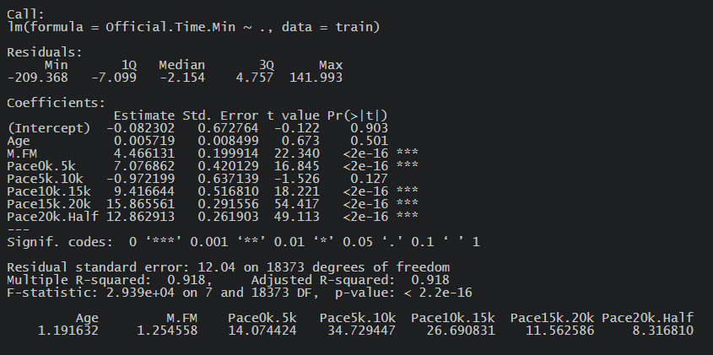
Ordinary Least Squares
R-squared value 0.918 for train data
R-squared value 0.915 for test data.
High VIF values suggesting multi-collinearity between independent variables.

Slide 19
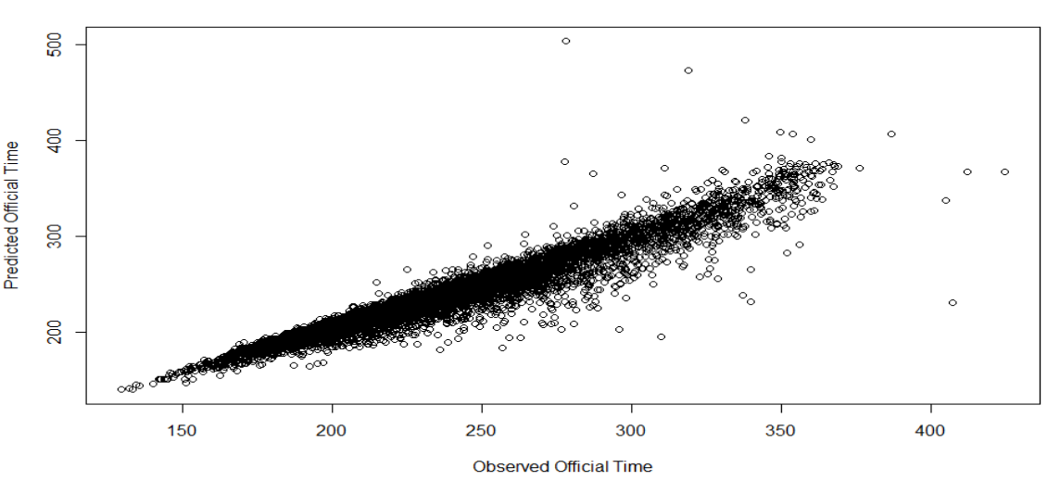
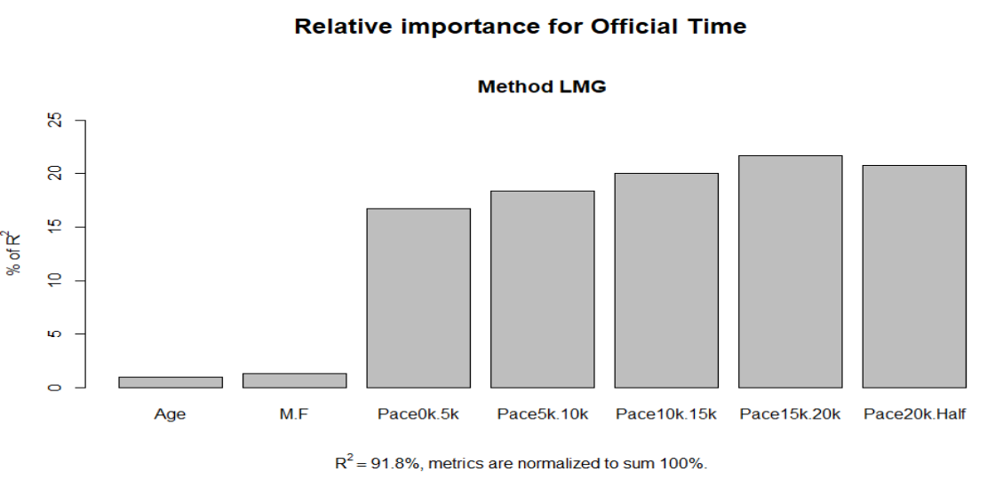
Ordinary Least Squares
Linear relationship between observed and predicted Official time
Pace between 15k and 20k, Pace between 20k and 21.1k are top two important features in explaining variability in Official time.

Slide 20
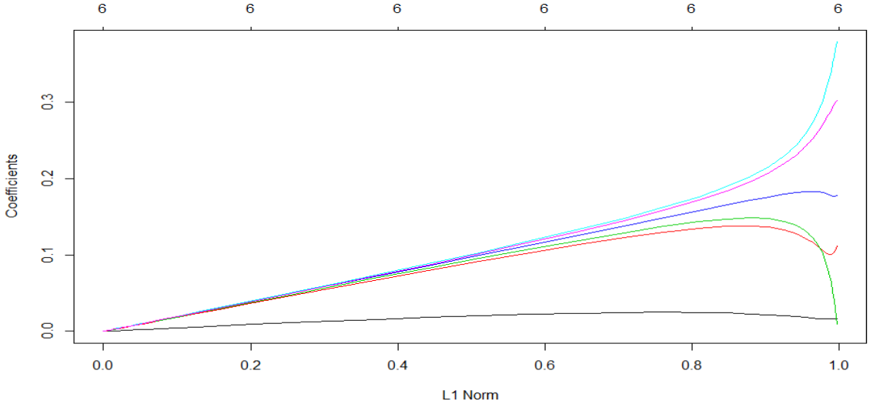
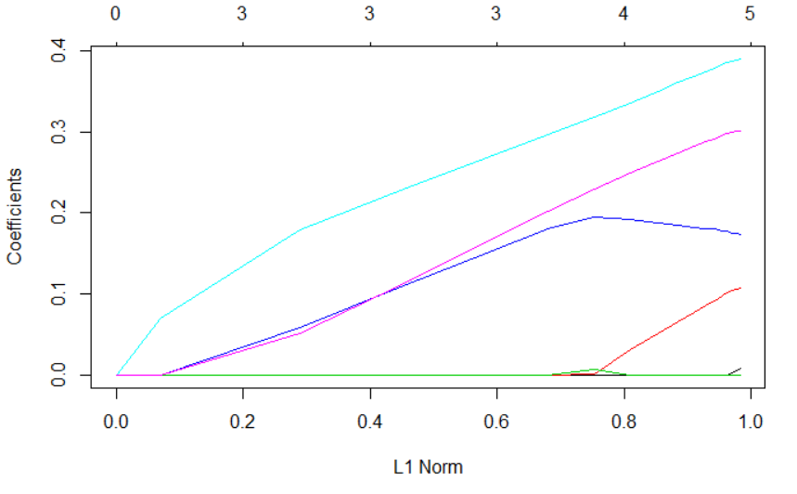
Lasso and Ridge Regression
R-squared value for Ridge is 0.9123 on Test data
R-squared value for Lasso is 0.9123 on Test data

Slide 21
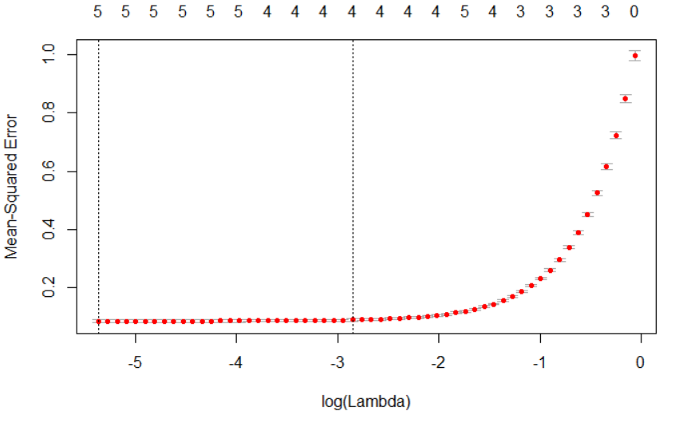
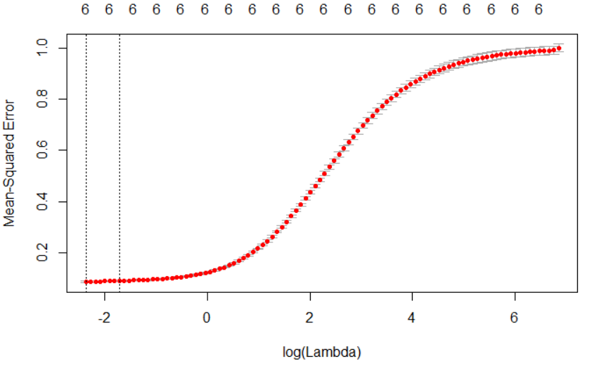
Lasso and Ridge Regression
Best Lambda value for Ridge is 0.0939
Best Lambda value for Lasso is 0.0046

Slide 22
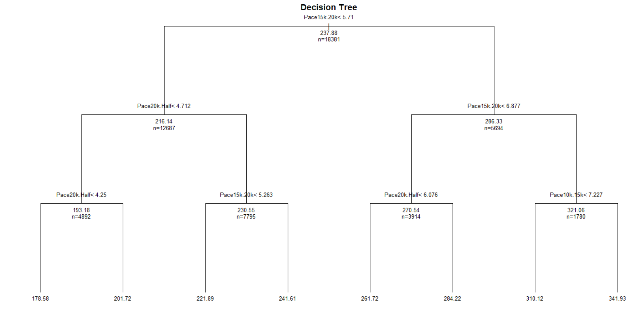
Decision Tree
R-squared value is 0.8864 on Test data

Slide 23
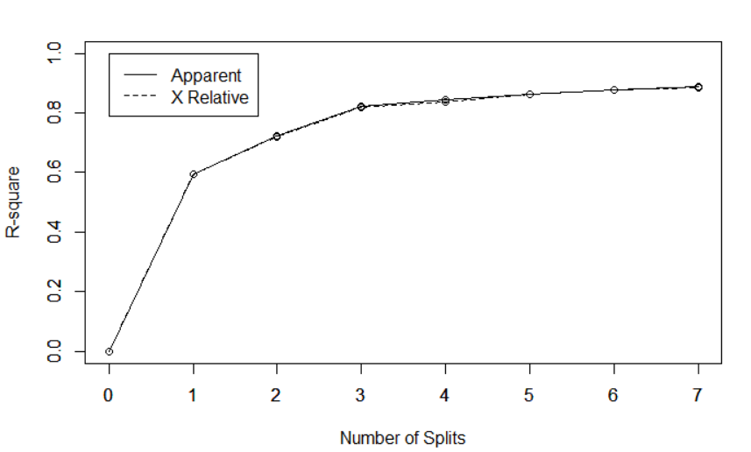
Decision Tree

Slide 24
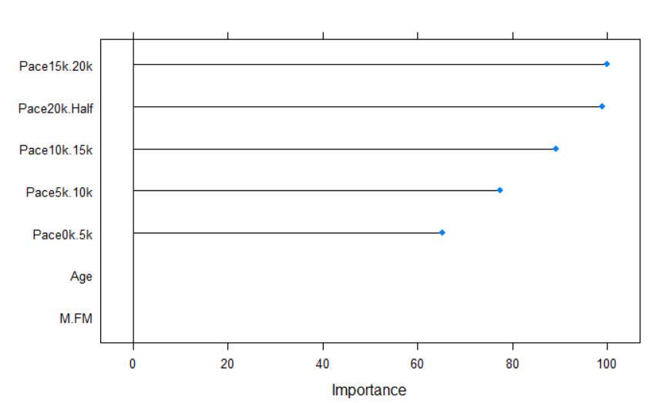
Bagging Tree
R-squared value is 0.905 on Test data

Slide 25
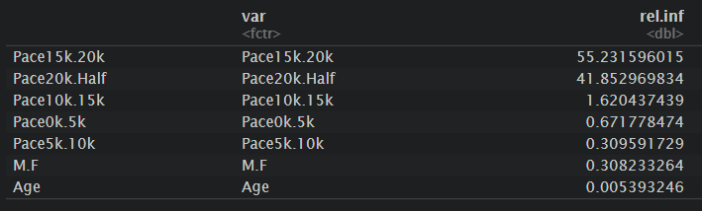
Gradient Boosting and xgboost
R-squared value for Gradient Boosting is 0.915 on Test data.
R-squared value for xgboost is 0.925 on Test data.

Slide 26
Models with R-squared values
Model | R2 value on Test data
Ordinary Least squares | 0.915
Lasso and Ridge Regression | 0.912
Decision Tree | 0.886
Bagging Tree | 0.905
Random Forest | 0.905
Gradient Boosting | 0.915
xgBoost | 0.925

Slide 27
Conclusion
K-means does an effective job at identifying the groups runners are assigned to because it is a top-down approach.
“Cool” feature engineering does not mean you will have improvements in your model. For example, our work on distance traveled from hometown failed to produce an effective model.
We can successfully build a model using KNN (with K=12) and linear regression to predict a runner’s finishing time based on their age, gender, and rank in the fourth quarter of the race.
Over 83% of variability in the the final rank is explained by fourth quarter rank, gender, and age and age, gender, and fourth quarter rank can predict your performance (top 25%, 50%, 75% or bottom 25%) with 72.5% accuracy rate.
2 Principal components cover 99% of the variance in the data. In principal component regression, 2 components explain 98% of the variability in the Official Time.
Out of all the models, xgboost is having the better r-square value of 0.925.
Pace between 15k and 20k and Pace between 20k and 21.1K are by far the top two important variables in all the models. So if a runner has better pace between 15k and 20k and 20k to 21.1k has the better chance of winning the race.

